Slide 1

Case Study 2: Raisin Classification (Nonlinear SVM)
Professor Bo Liu
James Watt School of Engineering

Slide 2
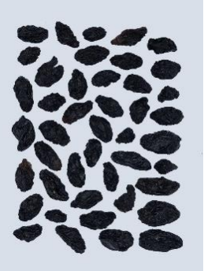
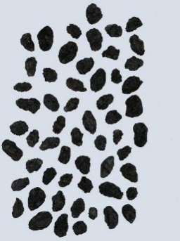
Nonlinear SVM – raisin classification
Turkey is one of the countries that ranks top in the world’s grape, 37% are dried.
Assessing the quality of raisin is essential.
Human-made procedures from traditional methods are inconsistent and inefficient.
Thus, we aim to develop alternative methods to quickly and precisely evaluate the basic features of raisins.
Two classes of raisin varieties are considered:
Besni
Kecimen

Slide 3
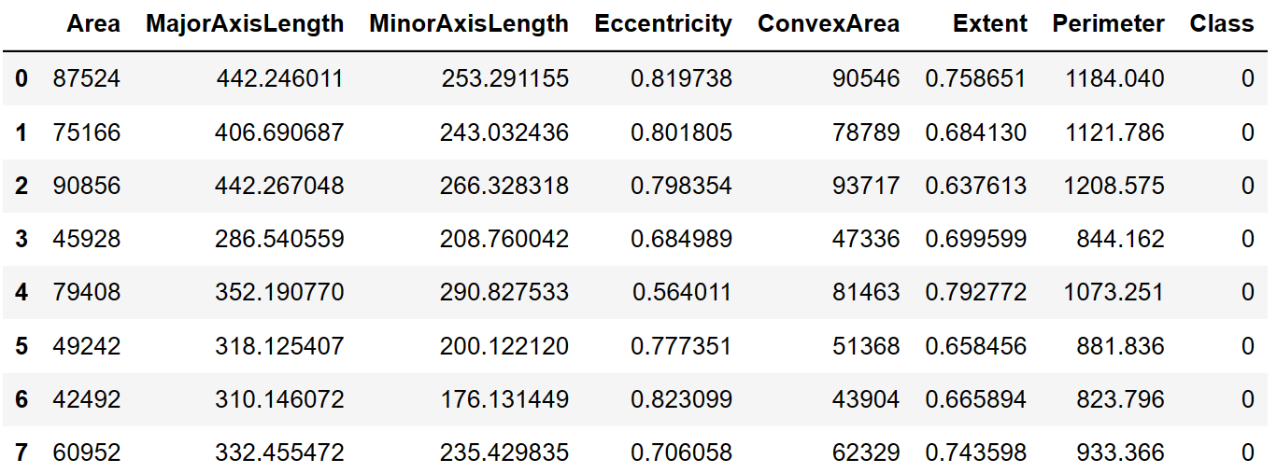
Nonlinear SVM – raisin classification
Features: (Area, MajorAxisLength, MinorAxisLength, Eccentricity, ConvexArea, Extent, Perimeter)
Class 1: Kecimen
Class 0: Besni
900 samples

Slide 4
Nonlinear SVM – raisin classification
1. Load the data
% Load data
data = readtable('raisin_dataset.csv');
X = data{:, 1:7}; % Features
y = data{:, 'Class'}; % Labels
column 1 to 7 are features
See live script

Slide 5
Nonlinear SVM – raisin classification
The following steps are similar to the linear cases, except that we need to specify the kernel function.
2. Train-test split
% Split into training and test data by the ratio 75% and 25%, respectively.
cvObj = cvpartition(size(X, 1), 'HoldOut', 0.75);
idx = cvObj.test;
X_train = X(idx, :); X_test = X(~idx, :);
y_train = y(idx, :); y_test = y(~idx, :);
See live script

Slide 6
Nonlinear SVM – raisin classification
3. Training
% Train SVM model
SVMModel = fitcsvm(X_train, y_train, 'KernelFunction', 'gaussian', 'Standardize', true);
We use gaussian kernel here.
You can try other kernels, such as RBF, polynomial, or linear.
4. Prediction
% Predict on test data
y_pred = predict(SVMModel, X_test);
accuracy_score = sum(y_test == y_pred)/length(y_test)*100;
disp(['Accuracy: ', num2str(accuracy_score)]);
Output:
Accuracy: 86.2222
See live script

Slide 7
Kernel selection code by an engineer
1. Load the data
% Load data
data = readtable('raisin_dataset.csv');
X = data{:, 1:7}; % Features
y = data{:, 'Class'}; % Labels
2. Set candidate kernels
kernels = {'polynomial', 'rbf', 'gaussian'}; % Candidate kernels
accuracy_scores = zeros(1, length(kernels)); % Accuracy scores of the candidate kernels
k = 20; % k controls the number of cross-validations.
See live script

Slide 8
Kernel selection code by an engineer
3. Cross-validation
for i = 1:k
% Split into training and test data by the ratio 75% and 25%, respectively.
cvObj = cvpartition(size(X, 1), 'HoldOut', 0.75);
idx = cvObj.test;
X_train = X(idx, :); X_test = X(~idx, :);
y_train = y(idx, :); y_test = y(~idx, :);
for j = 1:length(kernels)
% Train SVM model
SVMModel = fitcsvm(X_train, y_train, 'KernelFunction', kernels{j},'Standardize', true);
% Predict on test data
y_pred = predict(SVMModel, X_test);
% Calculate the accuracy scores of the j-th kernel
accuracy = sum(y_test == y_pred)/length(y_test);
accuracy_scores(j) = accuracy_scores(j) + accuracy;
end
end
data split
training and prediction
See live script

Slide 9

Kernel selection code by an engineer
4. Select kernel
accuracy_scores = accuracy_scores/k; % The average accuracy scores of these kernels
[max_acc,max_index] = max(accuracy_scores); % The max accuracy and the best kernel
disp(['Best kernel: ', kernels{max_index}]);
disp(['Average accuracy: ', num2str(max_acc)]);
5. The result
See live script

Slide 10
Questions
What is the difference between this cross-validation and the standard k-fold cross-validation? Which one is better?
The accuracy of using the Gaussian kernel this time is smaller than that of the previous experiment. Which one do you believe more?
Can the size of the BoxConstraint hyperparameter be used to improve the result? How?

Slide 11




Thanks!
#UofGWorldChangers
@UofGlasgow

